Slide 1
Group 5 - Hidden MArkov Model POS Tagging
By: Andrew Walker & Everett Wilson

Slide 2
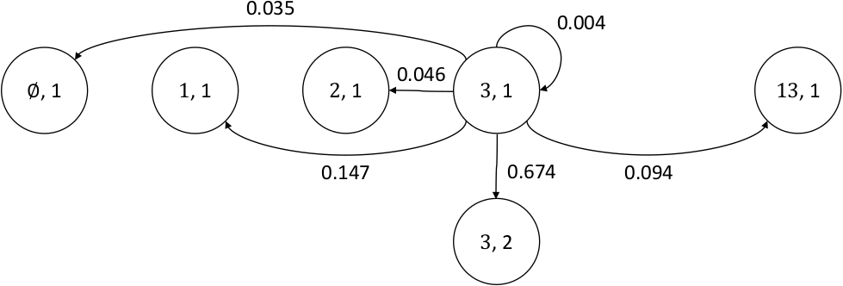
What is a Markov Chain?
A Markov chain is a stochastic model describing a sequence of possible events in which the probability of each event depends only on the state attained in the previous event
https://en.wikipedia.org/wiki/Markov_chain

Slide 3
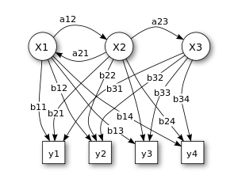
What is a Hidden Markov Model?
Hidden Markov Model (HMM) is a statistical Markov model in which the system being modeled is assumed to be a Markov process with unobserved (i.e. hidden) states.
https://en.wikipedia.org/wiki/Hidden_Markov_model

Slide 4
NLTK HiddenMarkovModelTrainer
Takes a corpus of tagged sentence
Creates a HiddenMarkovModelTagger object that is trained on the corpus
The main method is train_supervised() which takes a list of tagged sentences and returns the HiddenMarkovModelTagger object

Slide 5
NLTK HiddenMarkovModelTagger
Tagger that is trained by the HiddenMarkovModelTrainer
Provides a tag() method to tag a new sentence

Slide 6
HMMTagger2
Constructor:
Labeled_sequences: The training set, with the same format as those used by the HiddenMarkovModelTrainer
Substitute: A dictionary where the key is the (sub)set of the tags in the training set. Each tag that is the key of an entry is to be substituted by the corresponding values. Tags that do not appear in the dictionary are not substituted
tagger(): Returns the tagger object that is created by the constructor

Slide 7
Additional Methods
process_lines(): Takes a list of sentences and substitutes the tags with the dictionary

Slide 8
Process
Train on corpus with substituted tags Run on untagged corpus Compare results Profit

Slide 9
Demo

